Slide 1

Truck Fleet Analysis

Slide 2
CONTENTS
01
02
03
Problem Statement and Objective
Process Workflow
Structure of Data Sources
04
05
06
Visualization Stories
Prediction of Risk Factors
Challenges
07
Conclusion

Slide 3
Problem Statement and Objective
Problem Statement:
Az National Trucking (ANT), a long-distance trucking corporation based in California, is facing
an uptick in the number of traffic incidents and a subsequent increase in the cost of vehicle
insurance within its fleet. The primary challenges are related to drivers' non-compliance with
safety regulations and unsafe driving practices, including speeding, unsafe following distances, lane departure, and other hazardous behaviors. These incidents threaten the company’s
reputation, financial stability, and the safety of drivers, other road users, and cargo.
Business Objective:
We would like to identify hazardous truck drivers in California by analyzing the truck
fleet dataset for risk factors that significantly contributed to the increasing number of traffic incidents
By visualizing the dataset and identifying risk factors with a value of 7.0 or greater,
we would like to offer a personalized solution to ANT through our analysis

Slide 4

Process Workflow
Download Files
Move files from Local server to VMware Local server
Move files from VMware Local to HDFS
Create tables and load data into the tables in Impala
Connect Impala and Tableau using Impala ODBC Driver
Integrate Tableau and R
Visualize the data using Tableau
Build a predictive model using Tableau and R
Notes:
Step 1: Downloaded Files
We started by downloading the dataset that needs to be processed and visualized from the source
Step 2: Moved Files from Local Server to VMware Local Server
In the second step , we proceeded to transfer the files from our local server to VMware Local Server using scp command. This step ensures that the data is accessible within the virtual environment.
Step 3: Moved Files from VMware Local to HDFS
Then we moved the dataset to the (HDFS from local VMware. This step made the data available for processing and analysis within the Hadoop ecosystem.
Step 4: Created Tables and Loaded Data into Impala
Next, we organized and structured the data by creating tables in Impala. Once the tables are set up, we loaded the data from HDFS into these Impala tables for efficient querying and analysis.
Step 5: Connected Impala and Tableau using Impala ODBC Driver
Established a connection between Impala and Tableau using the Impala ODBC Driver. This allowed Tableau to interact with the data stored in Impala and create visualizations based on the queried results.
Step 6: Visualized the Data using Tableau
we used Tableau's interactive dashboards and visualization tools to analyze and present the data. The visualizations helped us identify risk factors, incident trends, and patterns within the dataset.
Step 7: Integrated Tableau and R
Finally ,we integrated Tableau with R and Built a predictive model using Linear Regression .

Slide 5
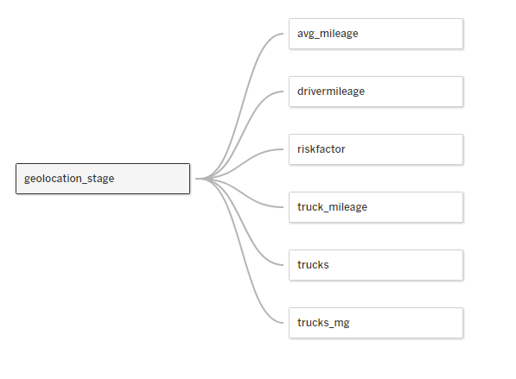
Structure of Data Sources

Slide 6
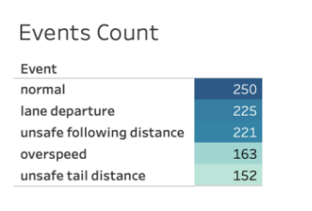
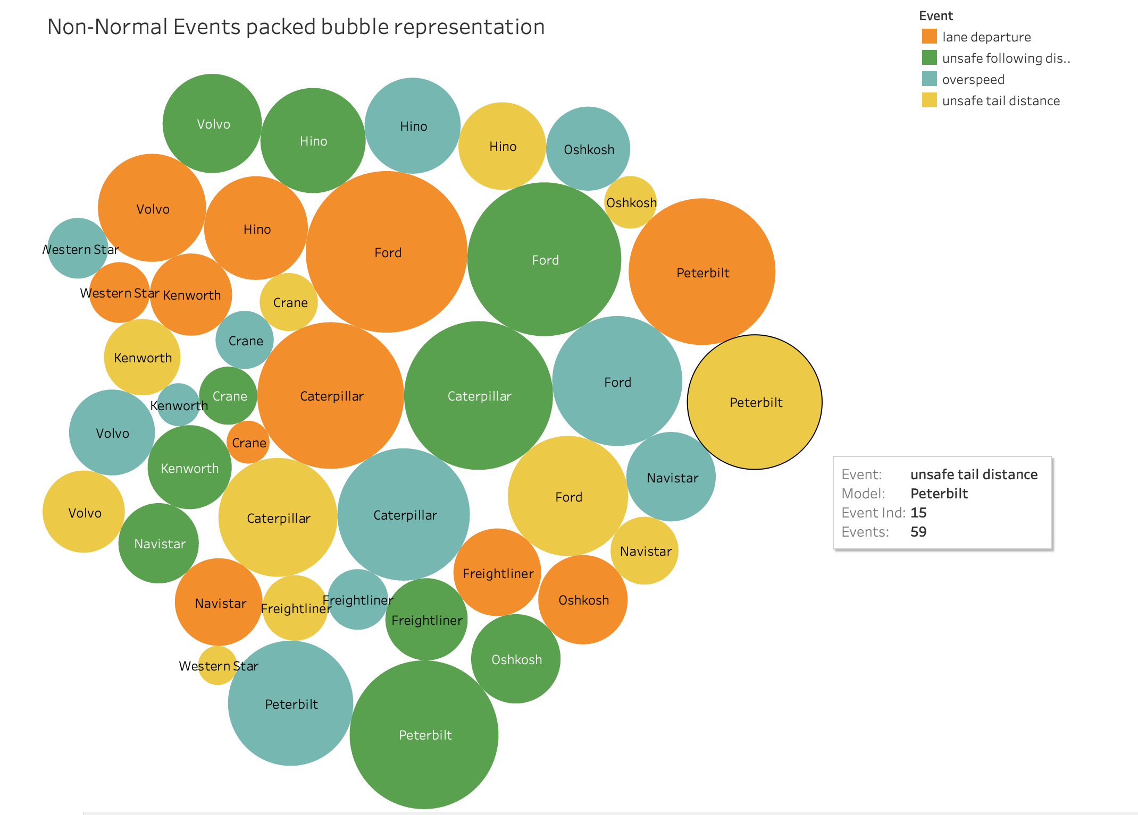
Story 1: Event detailing
This is the breakdown of events occurring:
Normal events: 250
Non-normal events: 761
The top 3 non-normal events:
Lane Departure
Unsafe Following Distance
Overspeed
Notes:
SLIDE 6 SCRIPT:
Now I’ll talk about story 1, event detailing. On the first graph on the upper left, we see the number of total events, titled as Events Count. The events are divided into two categories, consisting of normal and non-normal events. The total number of normal events is 250, and the total number of non-normal events is 761. After excluding the normal events, we can see from this chart the highest number of non-normal events, consisting of lane departure, unsafe following distance, over speeding, and unsafe tail distance. The lane departure category has recorded 225 events, the highest number of events among all of the non-normal events.
Let’s now look at the second graph, the bubble chart in the bottom right corner. Here, we wanted to identify the correlation between the top non-normal events and the car models. We can see in this chart that for each of the non-normal events such as lane departure, unsafe following distance, etc, the top 3 models across all categories were Ford, Caterpillar, and Peterbilt.

Slide 7
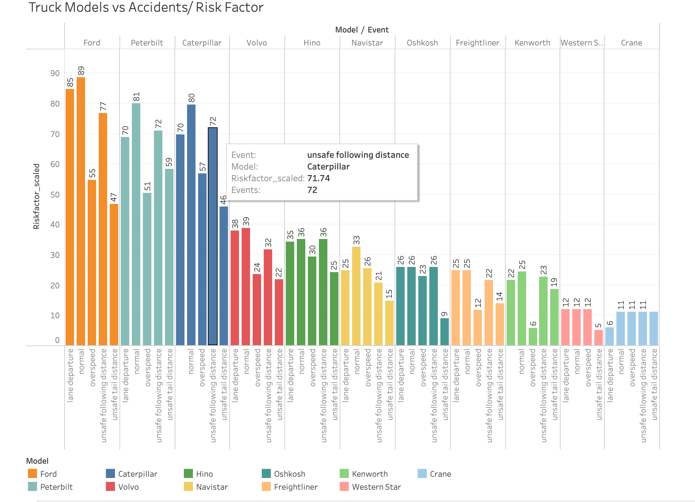
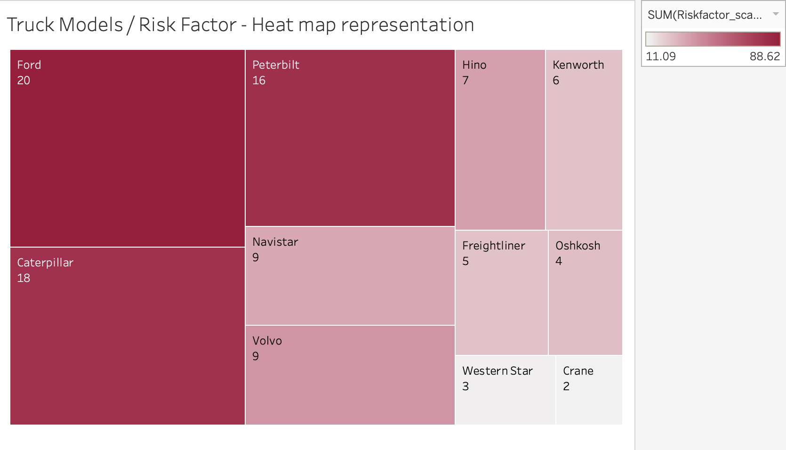
Story 2: Truck models that have the most significant impact on events with a high-Risk Factor.
The top 3 models contributing to events:
Ford - 89
Peterbilt - 81
Caterpillar - 80
Ford possesses the highest Risk Factor, which
stands at 20.
Notes:
SLIDE 7 SCRIPT:
Now for Story 2, Truck models that have the most significant impact on events with a high risk factor, Let’s take a closer look at the top 3 models contributing to the overall non-normal events. On the top left corner, the bar chart shows all of the truck models on the top, how much they have each contributed to the number of non-normal events, and also the subsequent scaled risk factor. We can infer from this bar chart that the top 3 models contributing to events are first Ford with 89, then Peterbilt with 81 events, and finally Caterpillar with 80 events. These findings match up with what we have concluded from the bubble chart from the previous slide. On the right side, we have used a heat map to measure the risk factor for each of the truck models. We can see that Ford has a risk factor of 20, while Caterpillar & Peterbilt have risk factors of 18 and 16, respectively. Therefore, the Ford truck model is once again shown to have the highest risk factor at 20.

Slide 8
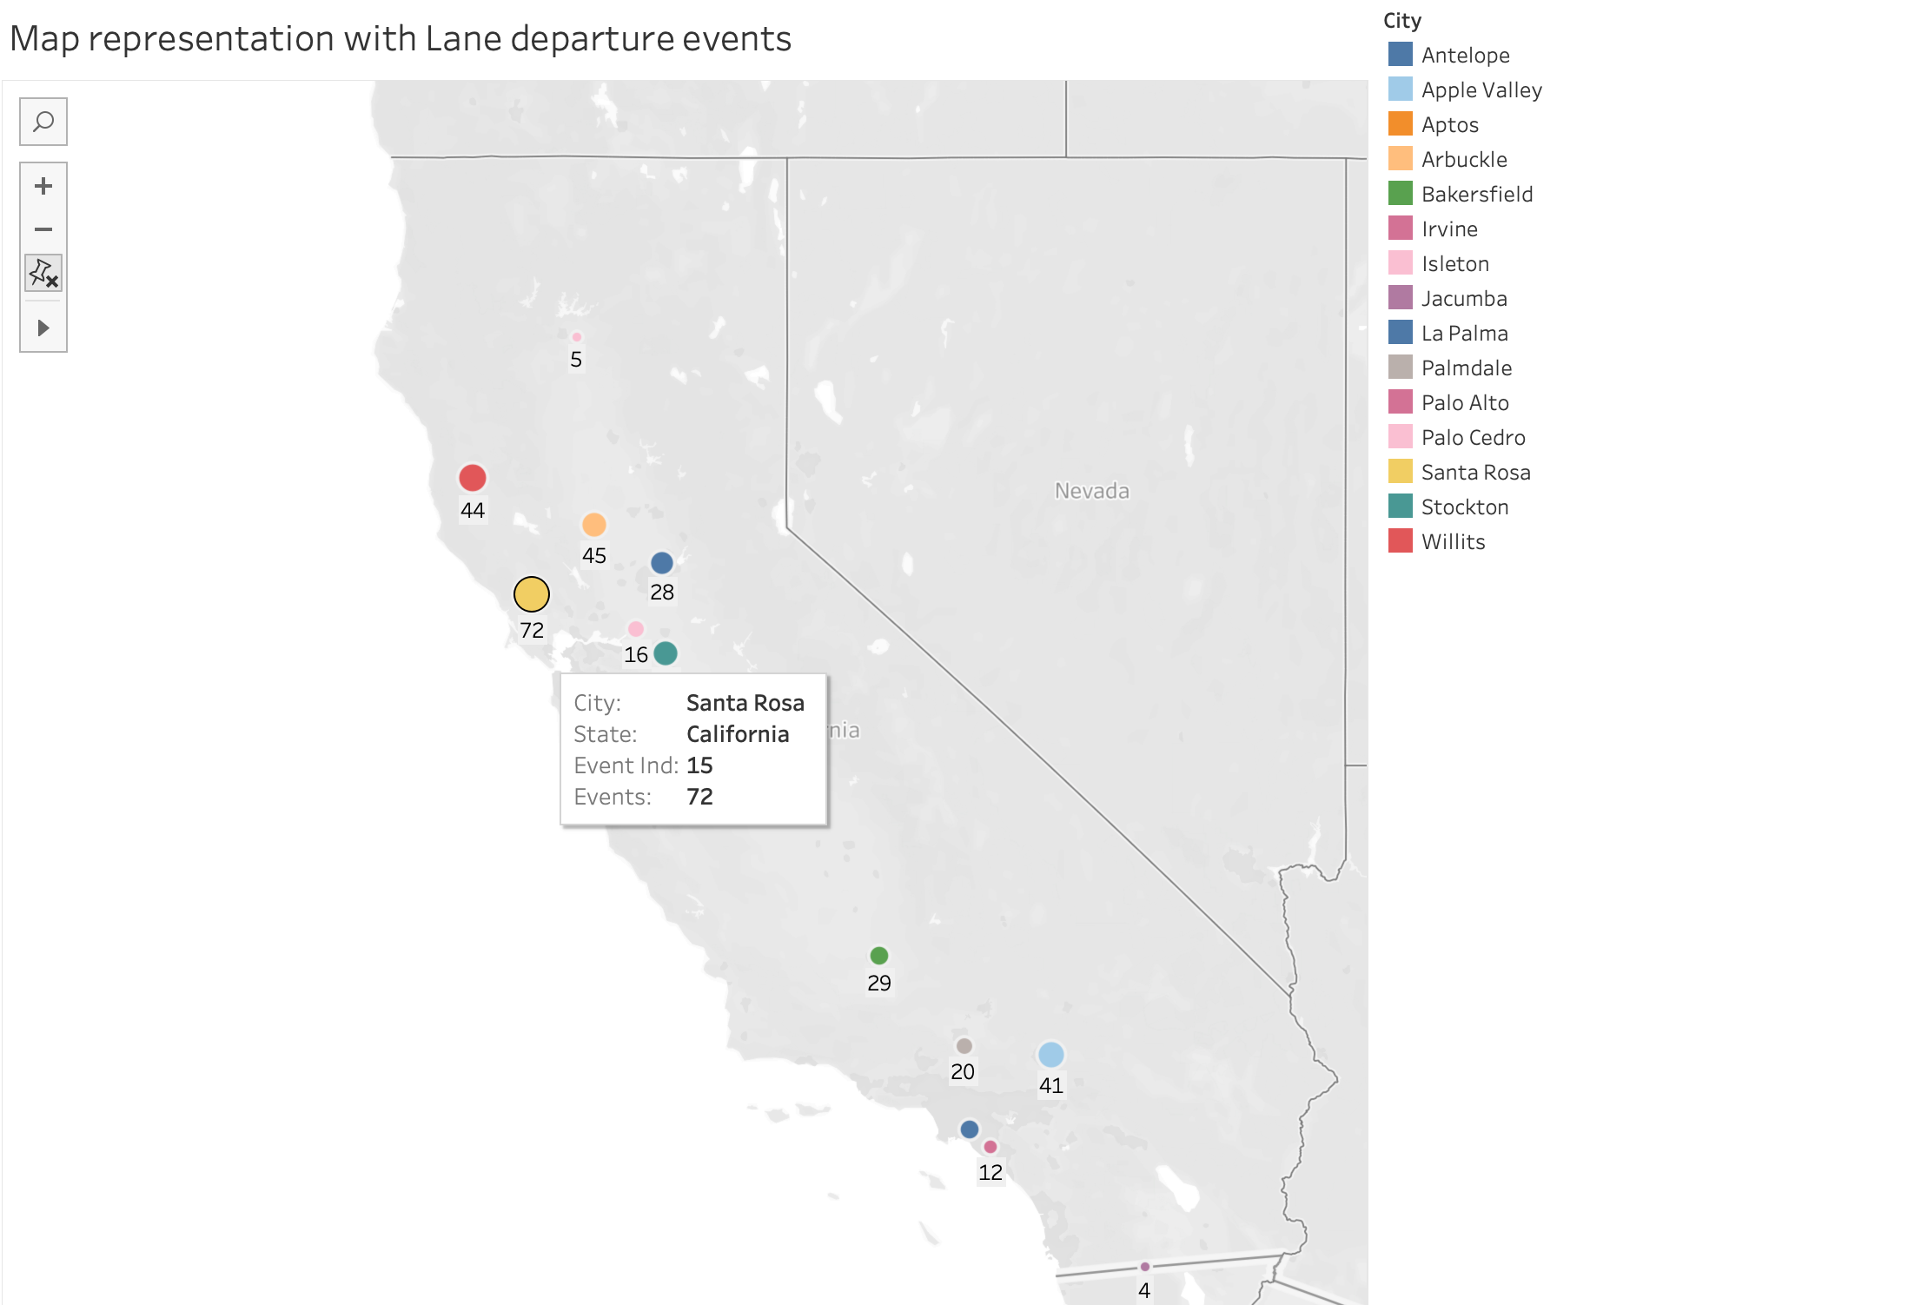
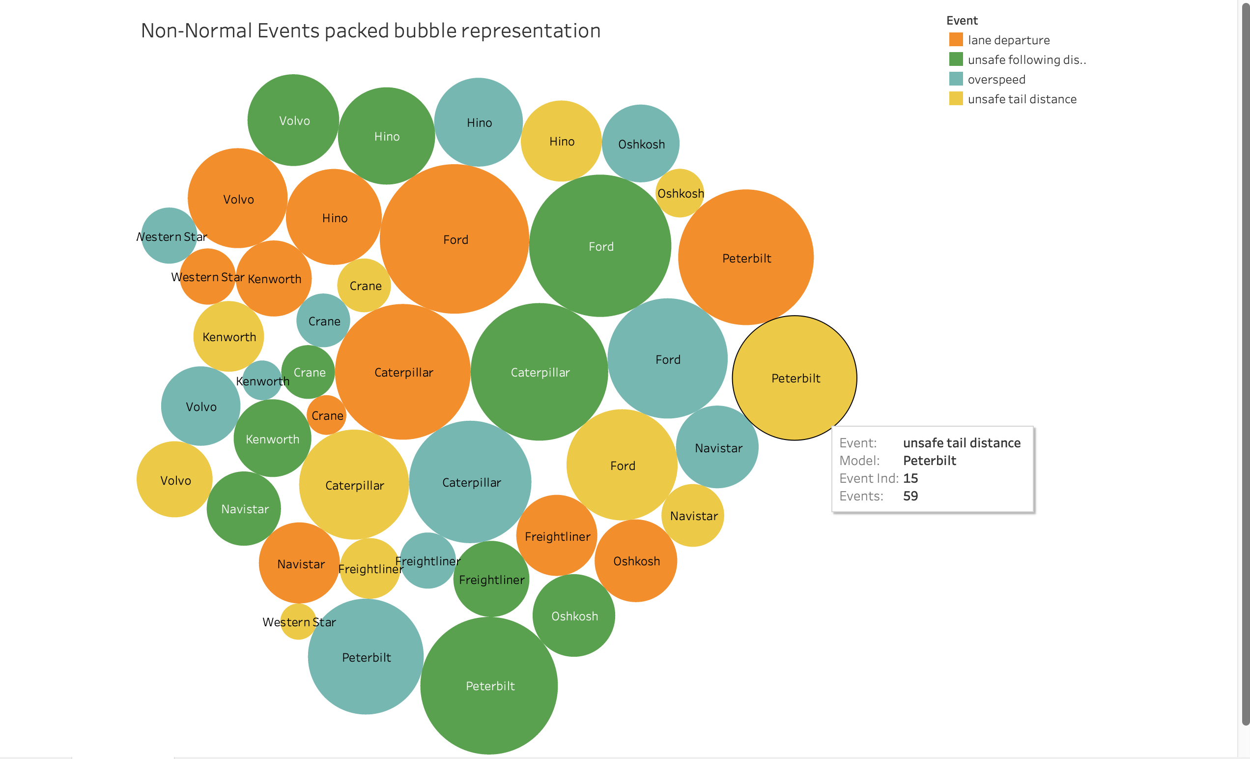
Story 3: Overview of most significant non-normal event
Top 15 California Cities with Highest Lane Departure Events, have been represented:
Santa Cruz Leads with 72 events
Ford, Caterpillar, and Peterbilt are the
vehicles warranting close monitoring
Lane departure events by the models:
Ford - 30
Caterpillar - 26
Peterbilt - 23
Notes:
we looked through the earlier slides, we noticed that a major chunk of events stems from non-normal incidents, In this slide we will be looking upon with Lane departure being the most frequent among them. So, we'll be focusing our attention on Lane Departure events.
Now, let's zoom in on the Californian cities. We've put together a neat dashboard showcasing the top 15 cities with the highest number of Lane departure occurrences. Santa Rosa takes the lead with a whopping 72 lane departure events and we should surely keep an eye on that!”
In our previous analysis, we examined the distribution of models and non-normal events. Now, in this packed bubble representation, we are further confirming our findings specifically for Lane departure events. Interestingly, we can observe that Ford, Peterbilt, and Caterpillar are the leading models contributing to Lane departure events.
To be more precise, Ford is associated with 30 Lane departure events, Caterpillar with 26 events, and Peterbilt with 23 events. These insights give us a clear understanding of the model-wise impact on Lane departure incidents.

Slide 9
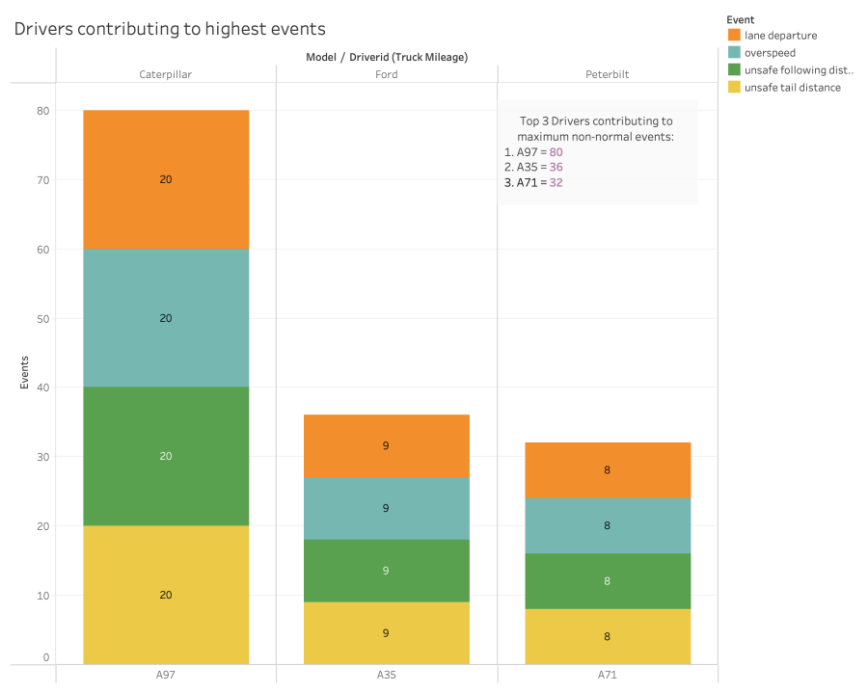
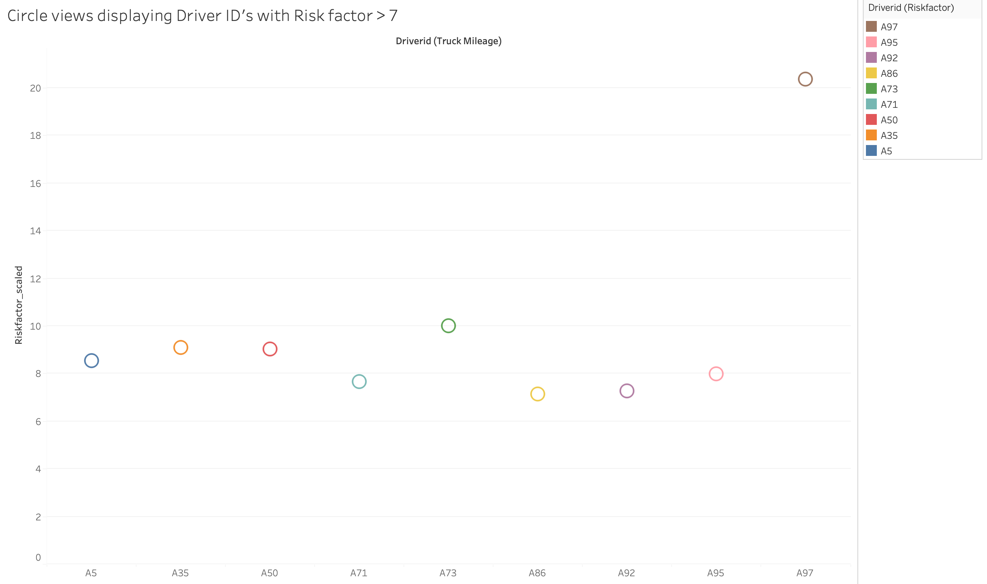
Story 4: Drivers responsible for the highest number of events
Top 3 Driver ID’s contributing to most of the non-normal events:
A97 – 80 (10 % of total )
A35 – 36 (4.7 % of total)
A73 – 32 (4.2 % of total)
When Focusing on Driver IDs with Risk
Factor > 7
A97 proves to be the outlier however with a Risk factor of 20.35
Notes:
Now, let's shift our focus to the drivers who operate these models. According to the bar chart, we can identify the top 3 driver IDs significantly contributing to the events: A97, A35, and A73. Impressively, A97 accounts for 80 events, which makes up 10% of the total incidents. A35 follows with 36 events, representing 4.7% of the total, and A73 with 32 events, making up 4.2% of the total.
To further explore the drivers with a risk factor greater than 7, we have created a dashboard with circle views. Among these drivers, we notice that A97 stands out as the outlier, with a remarkable risk factor of 20.35. This information offers valuable insights into driver-specific risks and their impact on the occurrences.

Slide 10
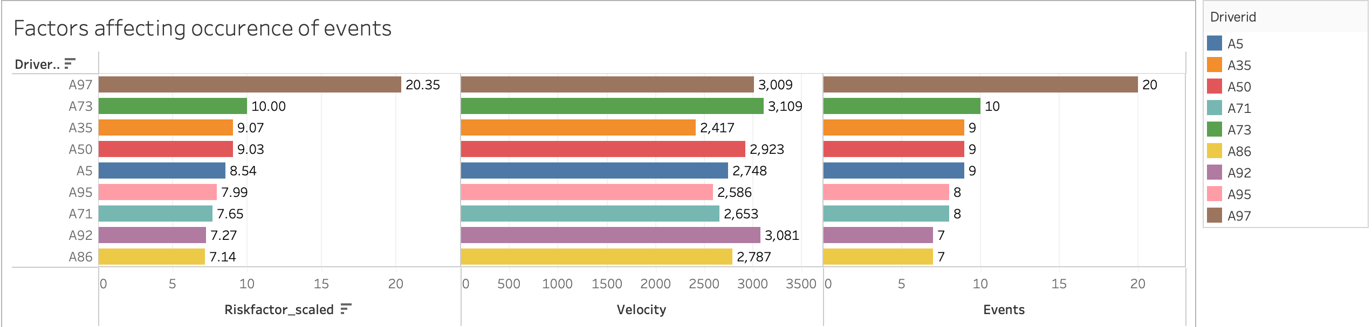
Story 4: Drivers responsible for the highest number of events (cont.)
Driver IDs with risk factor > 7 have been presented above
The speed (velocity) of the vehicle is a significant contributing factor to lane departure
incidents.
Following A97, it is evident that Driver ID A73 requires particular attention to effectively reduce accidents.
Notes:
Continuing with our investigation, we aim to identify the driver responsible for the most events and explore the factors influencing lane departure occurrences. Lane departure incidents are often linked to high-speed driving. Hence, we've introduced a velocity factor to monitor driving behavior and implement appropriate measures.
Upon analyzing the graph, we find that, except for the outlier A97 driver ID, A73 holds the second-highest risk factor. Interestingly, upon closer observation, we notice that A73 also exhibits the highest velocity among all drivers. Therefore, it is crucial to closely monitor the driving behavior of A73 to reduce the number of events and enhance risk management. By doing so, we can work towards improving overall safety and mitigating potential costs associated with risks.

Slide 11
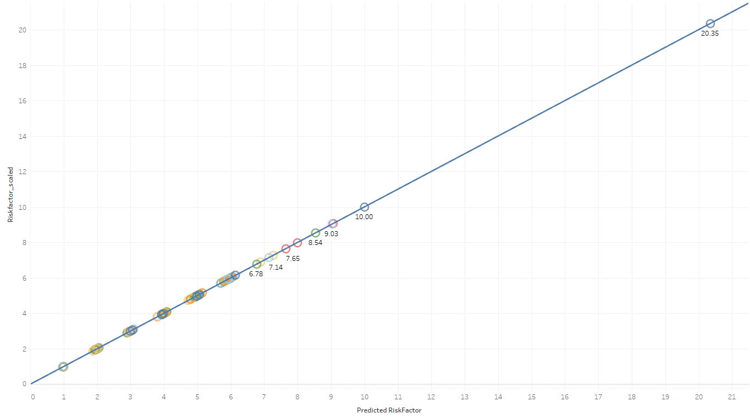
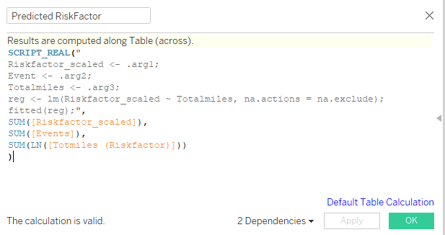
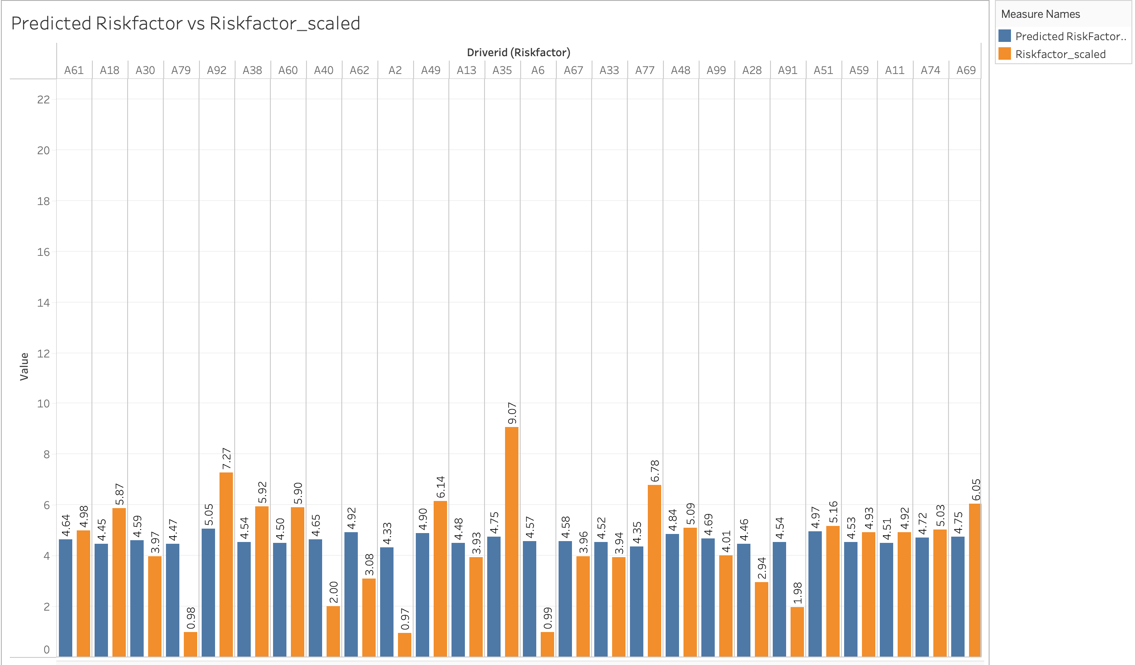
R Analysis
The given code predicts the values of the dependent variable “Riskfactor_scaled" based on a linear regression model using the independent variable "Events".
The values of "Riskfactor_scaled" can be reasonably estimated using a straight line that best fits the data points based on the values of "Events.”
A positive slope indicates that as the values of "Events” increase, the values of "Riskfactor_scaled" also tend to increase.
Notes:
Now, we'll showcase the R analysis conducted for the project. In the scatter plot, we present a linear model between "events" and "risk_factor." The given code enables us to predict the values of the dependent variable "Riskfactor_scaled" based on a linear regression model using the independent variable "Events."
• By employing this model, we can reasonably estimate the values of "Riskfactor_scaled" using a straight line that best fits the data points derived from "Events." • When observing the graph, a positive slope indicates that as "Events" increase, the values of "Riskfactor_scaled" also tend to increase.
Next, in the bar graph, each risk factor value corresponds to a predicted risk factor value. From the graph, we can deduce that the prediction model is well-tuned, as the predicted values are nearly equal to the actual values. This alignment suggests a high level of accuracy in the model's predictions.

Slide 12
Challenges
R integration for MAC:
Compatibility and Configuration
R Package Management
Security and Permissions
Dimension selection for the linear model:
Domain Knowledge
Multicollinearity
Dimension Transformation
Notes:
There are two major challenges that we have , the first one is integrating with R for MAC users. While integrating , we faced compatibility and configuration issues as Setting up R integration in Tableau for Mac might be more challenging compared to Windows. Also, Managing R packages and their dependencies might be different on Mac than on Windows. Ensuring that the required R packages are installed and accessible to Tableau can be a challenge. Security and permissions issues such as On macOS, security settings may prevent Tableau from executing R scripts by default. Users might need to grant appropriate permissions or modify security settings to allow Tableau to interact with R.
Another major challlenge is Dimension Selection for Linear Model. Choosing relevant dimensions for a linear model requires domain knowledge and understanding of the data. Selecting irrelevant or redundant dimensions may lead to a model with poor predictive power. Also, if selected dimensions are highly correlated with each other, it can cause multicollinearity issues in the linear model, leading to unstable coefficient estimates. Sometimes, linear models may perform better when certain dimensions are transformed (e.g., log-transformed) to meet the assumptions of the model. Identifying when and how to transform dimensions can be challenging.

Slide 13
Conclusion
1. Top 3 Trucks Contributing to Accidents are Ford, Peterbilt, and Caterpillar.
2. Ford - Highest Risk Factor.
3. Santa Rosa - Highest Lane Departure Events.
4. A97 - The Outlier
5. Focus on A73 after A97
6. Correlation Between Events and Risk Factor
Notes:
Top 3 Trucks Contributing to Accidents: The analysis indicates that Ford, Peterbilt, and Caterpillar are the top three truck manufacturers that contribute the most to accidents. These trucks may warrant special attention in terms of safety measures and regulations.
Ford Has the Highest Risk Factor: Among the identified truck manufacturers, Ford stands out with the highest risk factor. This suggests that Ford trucks might have a higher likelihood of being involved in accidents compared to the others.
Santa Rosa Leads in Lane Departure Events: The data reveals that Santa Rosa has the highest number of lane departure events, indicating a potential area of concern in terms of road safety and lane adherence.
A97 Identified as an Outlier: A97 is identified as an outlier in the dataset. This could imply that it exhibits significantly different behavior or characteristics compared to other data points, warranting further investigation.
Focus on A35 after A97: Following A97, A35 is suggested to be the next area of focus to improve event statistics. This indicates that A35 might have notable safety issues that need attention to reduce accidents or events.
Correlation Between Events and Risk Factor: The analysis shows that there is a positive correlation between the number of events (e.g., lane departure events) and the risk factor. This means that as the number of events increases, the risk factor also tends to increase, suggesting a potential relationship between these variables.

Slide 14
THANK YOU

